Slide 1
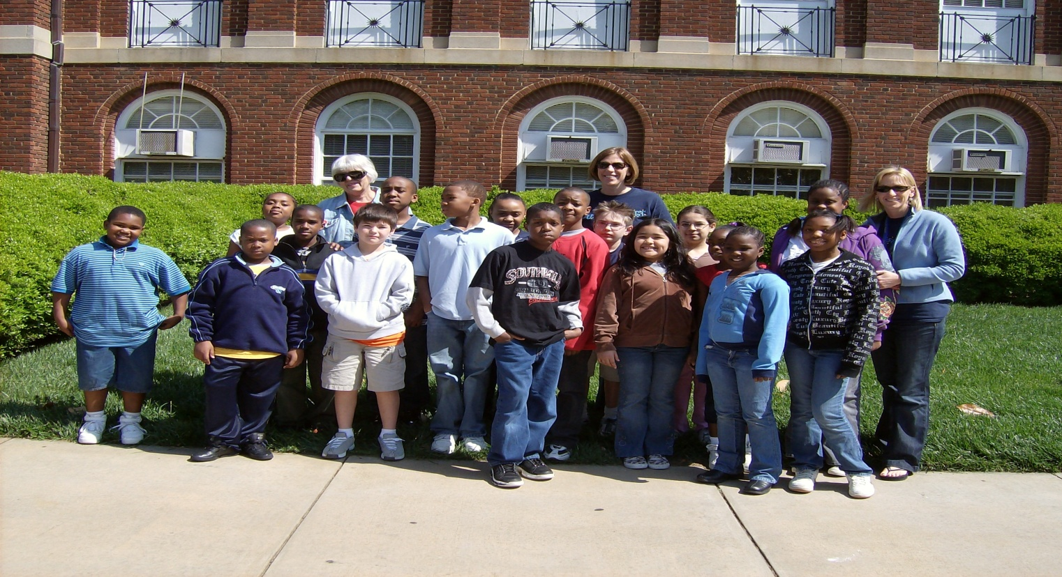
Pride Guide Mentor Program
Underwood Elementary

Slide 2
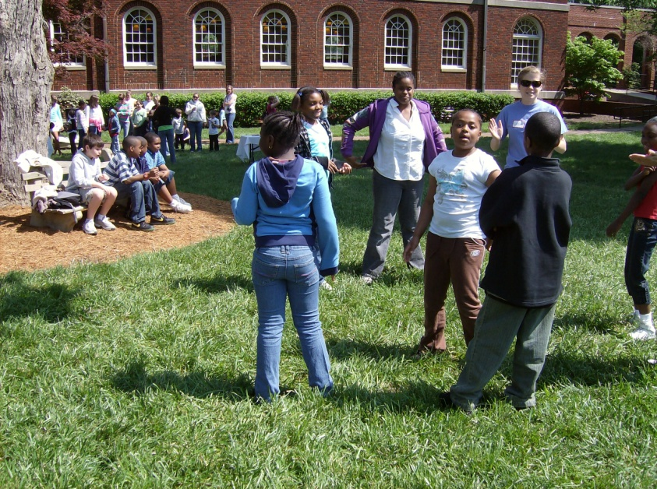
What is a mentor?
The notion of mentoring is ancient. The original Mentor was described by Homer as the "wise and trusted counselor" whom Odysseus left in charge of his household during his travels. Athena, in the guise of Mentor, became the guardian and teacher of Odysseus' son Telemachus.

Slide 3
What is a mentor at Underwood?
A mentor is a special type of volunteer (teacher, assistant, support staff).
A mentor is an individual committed to helping a student, identified as an at-risk student or a student who needs extra emotional support.
A mentor is committed to expending the time and energy the student needs here at school.

Slide 4
What does a mentor do at Underwood?
Builds a nonthreatening relationship with the student.
Is an effective listener.
Helps the student set short or long term goals.
Helps the student develop interests and opinions.
Helps them feel confident and good about themselves.
Helps them see school as a positive and fun place to be.

Slide 5
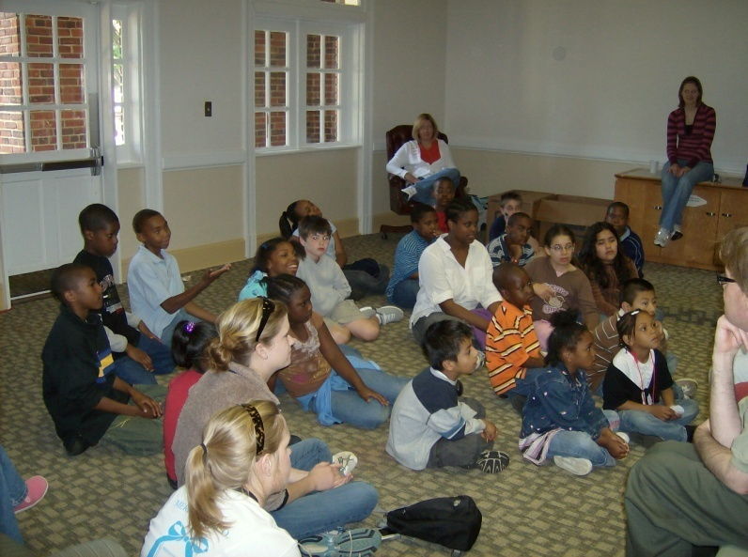
Your role
Support the child in a one to one relationship.
Be a positive role model and friend.
Participate in activities together.
Strive for mutual respect.
Build self-esteem and motivation.
Help set goals and work toward accomplishing them.

Slide 6
Time Commitment
At least one full school year.
Spend a minimum of 15 minutes with the student each week (rituals/routines).
Attend the 4 mentor/mentee group events after school.
Communicate regularly with your mentee

Slide 7
Benefits
Personal fulfillment.
Satisfaction in helping someone mature, and achieve goals.
Helps the classroom environment.
Helps the school as a whole.
Helps society!

Slide 8
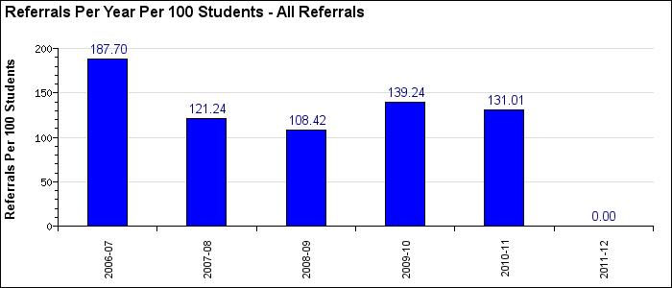
Data
Average referrals 2006-2011

Slide 9
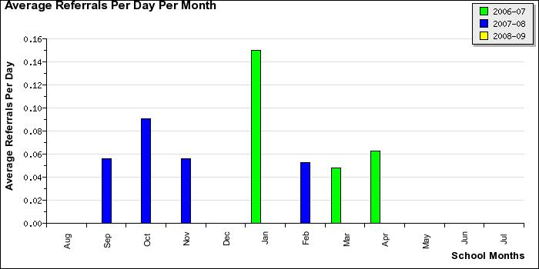
Student #1 with a mentor

Slide 10
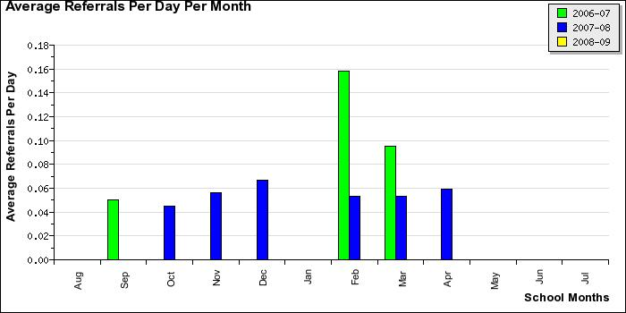
Student #2 with a mentor.

Slide 11
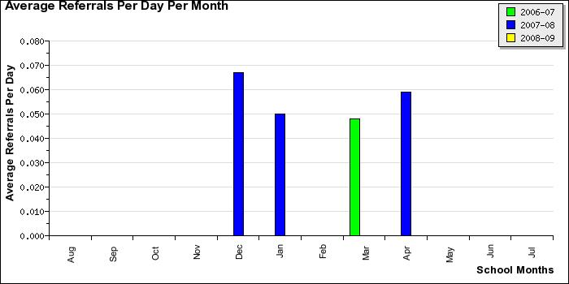
Student #3 without a mentor

Slide 12
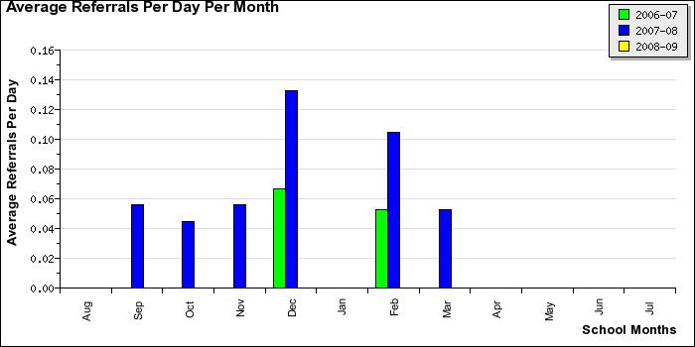
Student #4 without a mentor.

Slide 13
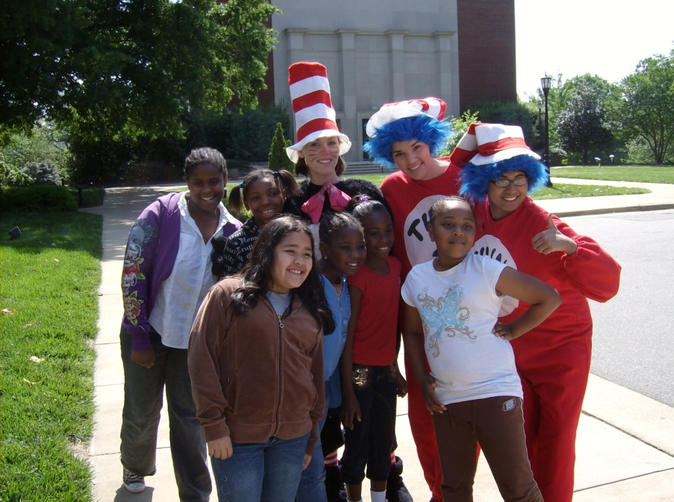
Finally….
I will send home a letter about the program to the specific parents.
You will then contact the parent and let them know your role.
Introduce yourself to the student and begin to connect with them weekly.

Slide 14
And…
See me anytime with questions.
I have a TON of resources in my office.
Ask questions of other mentors.
Every man has within himself a continent of undiscovered character. Happy is he who proves the Columbus of his soul. - Goethe

